Slide 1
Text Processing
Storage (Tries)
Encoding n Compression (Huffman Code)
Pattern Matching

Slide 2
Text storage
EBCDIC/ASCII
Array of character
Linked list of character
Trees - B Tree, Tries
Stuart E. Madnick, “String Processing Techniques,” Communications of the ACM, Vol 10, No 7, July 1967, pp 420-424.

Slide 3
Pattern Matching (Recognition)
Pattern Matching finds occurrences of a predefined pattern in the data.
Applications include speech recognition, information retrieval, time series analysis.

Slide 4
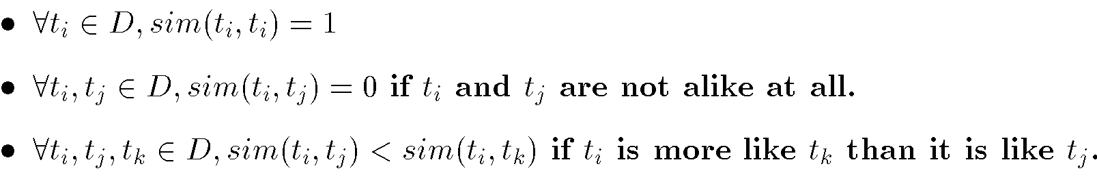
Similarity Measures
Determine similarity between two objects.
Similarity characteristics –
Alternatively, distance measures measure how unlike or dissimilar objects are.

Slide 5
String Matching Problem
Given a text string ‘S’, the problem of string matching deals with finding whether a pattern ‘p’ occurs in ‘S’ and if ‘p’ does occur then returning position in ‘S’ where ‘p’ occurs.

Slide 6
String Matching Problem
Input:
  Pattern – length m
  Text string – length n
Find one (next, all) occurrences of pattern in string
Ex:
  String: 00110011011110010100100111
  Pattern: 011010

Slide 7
Approximate String Matching
Find patterns “close to” the string
Applications:
  Spelling checkers
  Information Retrieval
Define similarity (distance) between string and pattern
Fuzzy matching

Slide 8
Brute Force String Matching
Brute Force Method –
One of the most obvious approach would be to compare the first element of the pattern to be searched ‘p’, with the first element of the string ‘S’ in which to locate ‘p’.
If the first element of ‘p’ matches the first element of ‘S’, compare the second element of ‘p’ with second element of ‘S’.
If match found proceed until entire ‘p’ is found,
If entire ‘p’ is found return ‘True’, position.
If a mismatch is found at any position, shift ‘p’ one position to the right and repeat comparison.

Slide 9
Brute Force String Matching –
Working
It works in O(mn) as follows,
String S
a | b | c | a | b | a | a | b | c | a | b | a | c
Pattern p
a | b | a | a

Slide 10
Brute Force String Matching –
Working
Step 1:compare p[1] with S[1]
S
a
b
c
a
b
a
a
b
c
a
b
a
c
p
a
b
a
a
Step 2: compare p[2] with S[2]
S
a
b
c
a
b
a
a
b
c
a
b
a
c
p
a
b
a
a

Slide 11
Brute Force String Matching –
Working
Step 3: compare p[3] with S[3]
S
a
b
c
a
b
a
a
b
c
a
b
a
c
p
a
b
a
a
Mismatch occurs here..
Since mismatch is detected, shift ‘p’ one position to the right and
repeat the matching procedure.

Slide 12
Brute Force String Matching –
Working
S
a
b
c
a
b
a
a
b
c
a
b
a
c
p
a
b
a
a
Finally, a match is found after shifting ‘p’ three times to the right side.
If ‘m’ is the length of pattern ‘p’ and ‘n’ the length of string ‘S’, the matching time is of the order O(mn).
This is a certainly a very slow running algorithm.

Slide 13
Brute Force String Matching –
Drawbacks
What makes this approach so slow is the fact that elements of ‘S’ with which comparisons had been performed earlier are involved again and again in comparisons in some future iterations.
Example –
when a mismatch is detected for the first time, the pattern ‘p’ would be moved one position to the right and matching procedure would resume from there.
Now, the first comparison that would take place would be a repetition.
It is these repetitive comparisons that lead to the runtime of O(mn).

Slide 14
Brute Force String Matching
Brute Force
  Space O(m+n)
  Time O(mn)
00110011011110010100100111
  011010
  011010
  011010

Slide 15
Brute Force String Matching
They use tools / techniques called as the,
Finite State Recogniser (FSR), or,
Finite State Machines (FSM), also known as
Finite State Automation (FSA)

Slide 16
Finite state machines consist of 4 main elements,
States which define behavior and they may produce actions.
State transitions, which are movement from one state to another.
Rules or conditions that must be met to allow a state transition.
Input events which are either externally or internally generated, which may possibly trigger rules and lead to state transitions.
Notes:
A finite state machine must have an initial state which provides a starting point, and a current state which remembers the product of the last state transition.
Received input events act as triggers, which cause an evaluation of some kind of the rules that govern the transitions from the current state to other states.

Slide 17
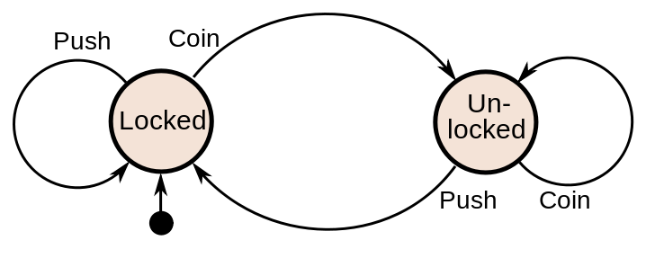
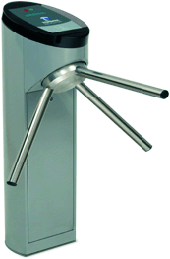
Finite State Machine - Example
Example: a turnstile
Current State | Input | Next State | Output
Locked | coin | Unlocked | Release turnstile so customer can push through
 | push | Locked | None
Unlocked | coin | Unlocked | None
 | push | Locked | When customer has pushed through lock turnstile

Slide 18
Regular Expressions
Notation for describing a set of strings, possibly of infinite size
ε denotes the empty string
ab + c denotes the set {ab, c}
a* denotes the set {ε, a, aa, aaa, ...}
Examples
  (a+b)* all the strings from the alphabet {a,b}
  b*(ab*a)*b* strings with an even number of a’s
  (a+b)*sun(a+b)* strings containing the pattern “sun”
  (a+b)(a+b)(a+b)a 4-letter strings ending in a

Slide 19
Regular Expressions
? * + . ^
Pattern
colou?r | color colour
oo*h! | oh! ooh! oooh! ooooh!
o+h! | oh! ooh! oooh! ooooh!
baa+ | baa baaa baaaa baaaaa
beg.n | begin begun begun beg3n
^a-zA-Z | abcdABC

Slide 20
Regular Expressions
Example – Find all instances of the word “the” in a text.
the
What about The?
Missed capitalized examples - [tT]he
Incorrectly returns ‘other’ or ‘theology’ –
[^a-zA-Z][tT]he[^a-zA-Z]

Slide 21
Regular Expressions - Errors
The process we just went through was based on fixing two kinds of errors
  Matching strings that we should not have matched (there, then, other)
    False positives
  Not matching things that we should have matched (The)
    False negatives

Slide 22
Regular Expressions
Regular expressions play a very large role in text processing
  Sophisticated sequences of regular expressions are often the first model for any text processing text
For many hard tasks, we use machine learning classifiers
  But regular expressions are used as features in the classifiers
  Can be very useful in capturing generalizations

Slide 23
String Matching
The Knuth-Morris-Pratt Algorithm

Slide 24
Knuth-Morris-Pratt (KMP)
Knuth, Morris and Pratt proposed a linear time algorithm for the string matching problem.
A matching time of O(n) is achieved by avoiding comparisons with elements of ‘S’ that have previously been involved in comparison with some element of the pattern ‘p’ to be matched. i.e., backtracking on the string ‘S’ never occurs

Slide 25
Knuth-Morris-Pratt (KMP)
Apply FSM to string by processing characters one at a time.
Accepting state is reached when pattern is found.
Space O(m+n)
Time O(m+n)

Slide 26
Knuth-Morris-Pratt (KMP)
The KMP string searching algorithm differs from the brute-force algorithm by keeping track of information gained from previous comparisons.
A failure function (f) is computed that indicates how much of the last comparison can be reused if it fails.
Specifically, f is defined to be the longest prefix of the pattern P[0,..,j] that is also a suffix of P[1,..,j], Note: not a suffix of P[0,..,j], it is termed as the prefix function.

Slide 27
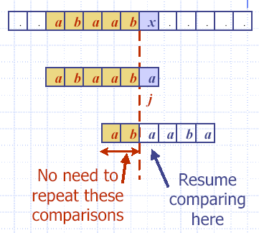
Knuth-Morris-Pratt (KMP)
The prefix function shows how much of the beginning of the string matches up to the portion immediately preceding a failed comparison.

Slide 28
String Matching
Sliding Window Approach

Slide 29

Sliding Window Approach
Nearly all of the exact string matching algorithms use the slide window approach.
Whenever a mismatching is found, the pattern is moved to the right.

Slide 30

The Suffix to Prefix Rule
For a window to have any chance to match a pattern, in some way, there must be a suffix of the window which is equal to a prefix of the pattern.

Slide 31
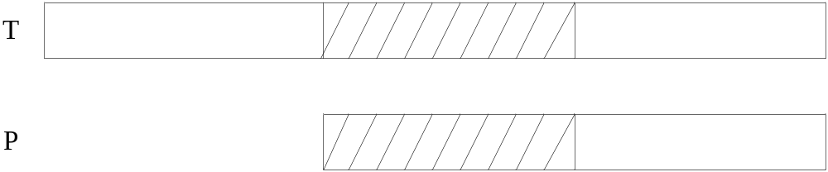
The Implication of the Rule
Find the longest suffix U of the window which is equal to some prefix of P.
Skip the pattern as follows:

Slide 32
Example
T = GCATCGACAGACTATACAGTACG
P = GACGGATCA
The longest suffix of the window which is equal to a prefix of P is “GAC” = P(1, 3) , slide the window by 6.
T = GCATCGACAGACTATACAGTACG
P = GACGGATCA

Slide 33
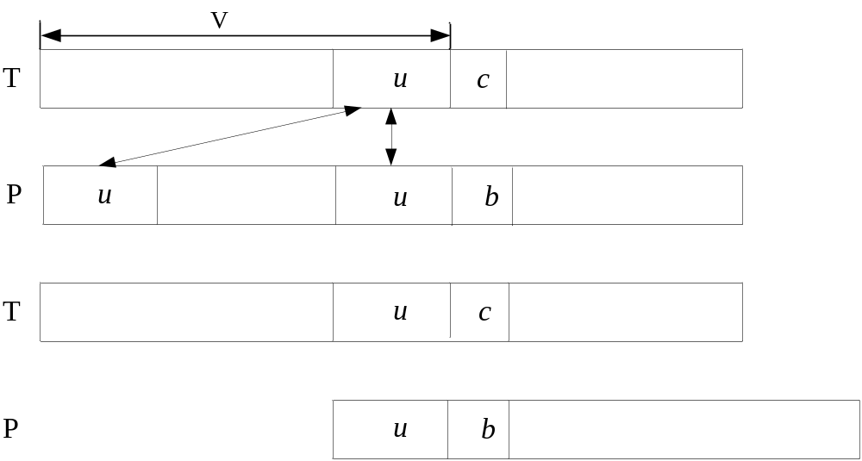
Skip the pattern by the rule

Slide 34
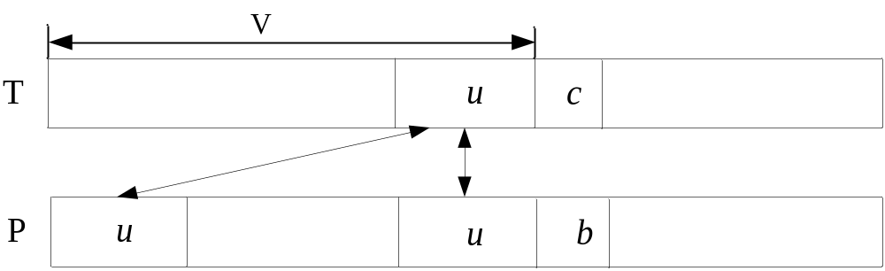
But, if we have to do the finding of the longest suffix in run time, the algorithm will be very inefficient.
Pre-processing can eliminate the problem because u also exists in P.

Slide 35
The KMP Algorithm pre-processes the pattern P and produces the prefix function to determine the number of steps the pattern skips.

Slide 36
Example
T = GCATCGACGAGAGTATACAGTACG
P = GACGACGAG
P(1, 2) = P(4, 5) = ‘GA’, slide the window by 3.
T = GCATCGACGAGAGTATACAGTACG
P = GACGACGAG
Note - The Algorithm knows it can skip 3 steps because of the pre-processing.
The prefix function can be obtained recursively.

Slide 37
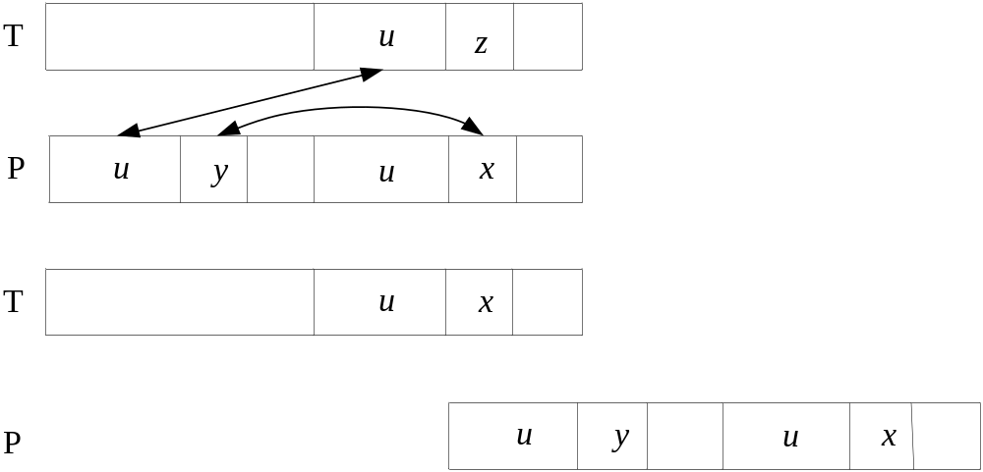
The KMP algorithm makes a further checking on P. If x = y, skip further.

Slide 38
Example
T = GCATCGACGAGAGTATACAGTACG
P = GACGACGAG
P(1, 2) = P(4, 5) = ‘GA’. But p₃ = p₆ = ‘C’.
Slide the window by 5.
T = GCATCGACGAGAGTATACAGTACG
P = GACGACGAG

Slide 39
KMP Advantages
KMP runs in optimal time: O(m+n)
  very fast
The algorithm never needs to move backwards in the input text, T
  this makes the algorithm good for processing very large files that are read in from external devices or through a network stream

Slide 40
Other String matching algorithms
There are many exact string matching algorithms.
Nearly all of them are concerned with how to slide the pattern.
A listing of some of them are,

Slide 41
Backward Algorithm
Boyer and Moore Algorithm
Colussi Algorithm
Crochemore and Perrin Algorithm
Galil Gianardo Algorithm
Galil and Seiferas Algorithm
Horsepool Algorithm
Knuth Morris and Pratt Algorithm
KMP Skip Algorithm
Max-Suffix Matching Algorithm
Morris and Pratt Algorithm
Quick Searching Algorithm

Slide 42
Raita Algorithm
Reverse Factor Algorithm
Reverse Colussi Algorithm
Self Max-Suffix Algorithm
Simon Algorithm
Skip Search Algorithm
Smith Algorithm
Tuned Boyer and Moore Algorithm
Two Way Algorithm
Uniqueness Algorithm
Wide Window Algorithm
Zhu and Takaoka Algorithm

